Slide 1
Scene+: Schema validation at API management

Slide 2
With the new approach, schema and parameter-level validation will be captured at an early stage within the API Management (APIM) layer.
This ensures that any malformed or bad requests are identified and returned to the client before reaching the backend services.
This will also prevent unnecessary traffic from burdening the backend systems.
The backend services will continue to perform schema and business-level validations to catch any requests that bypass the APIM layer.
We are leveraging the native capabilities of the APIM infrastructure to efficiently perform schema validation.

Slide 3
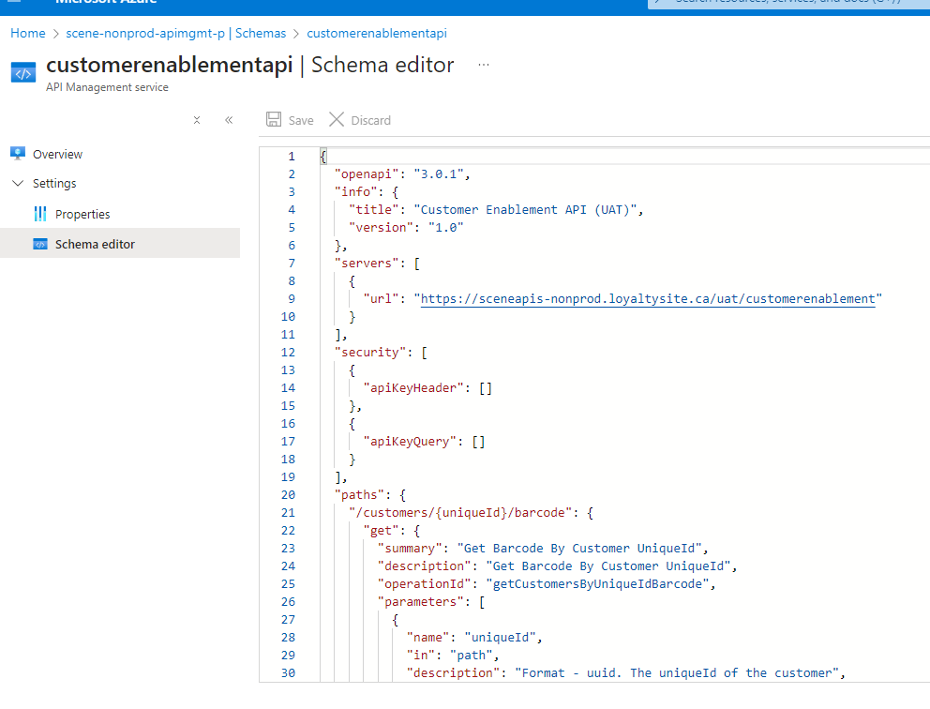

Slide 4
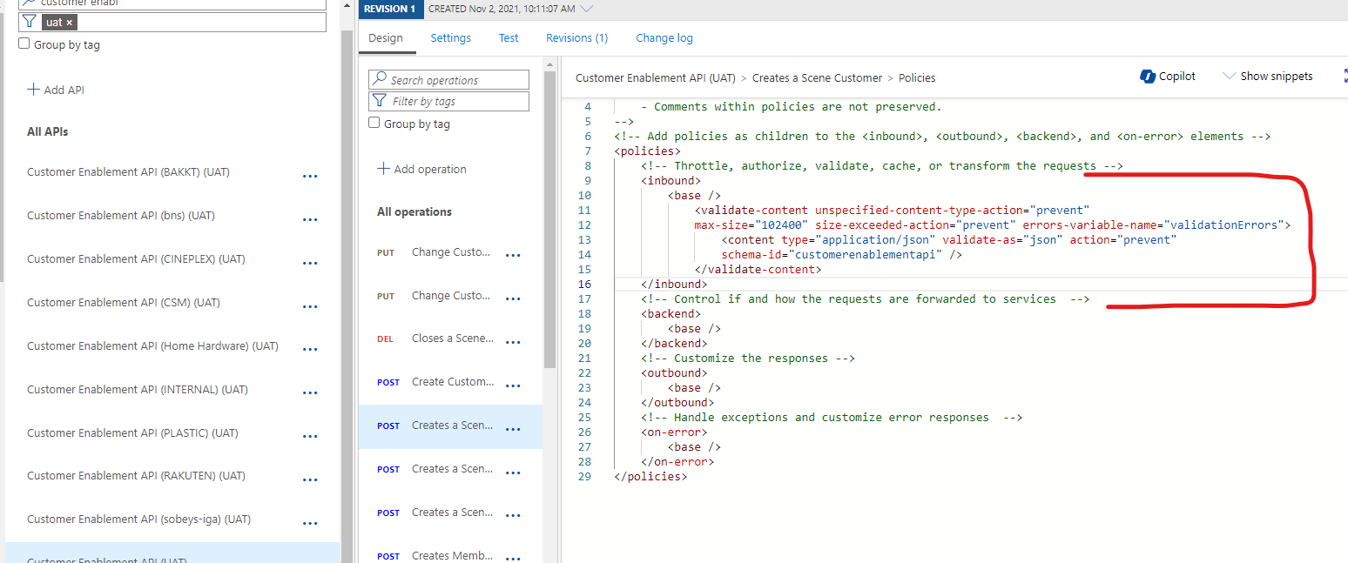

Slide 5
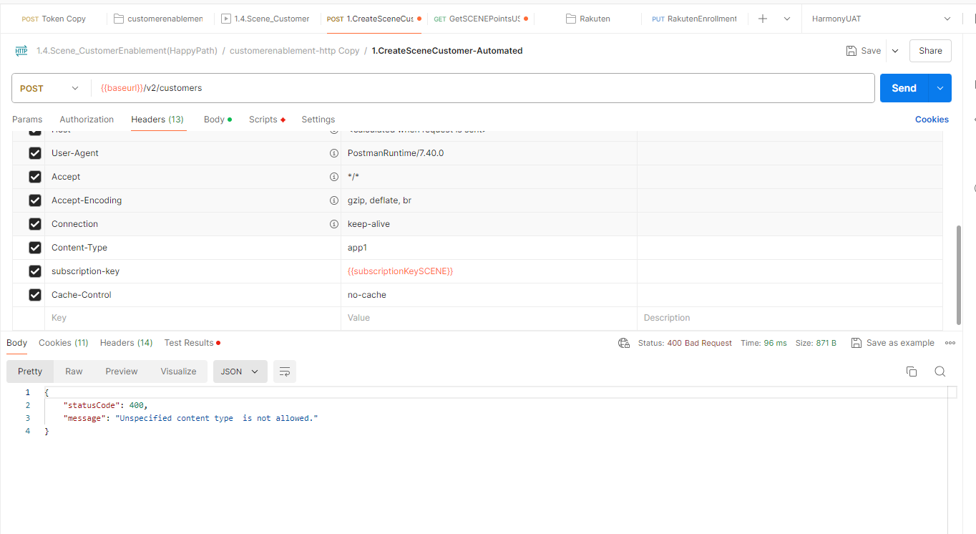

Slide 6
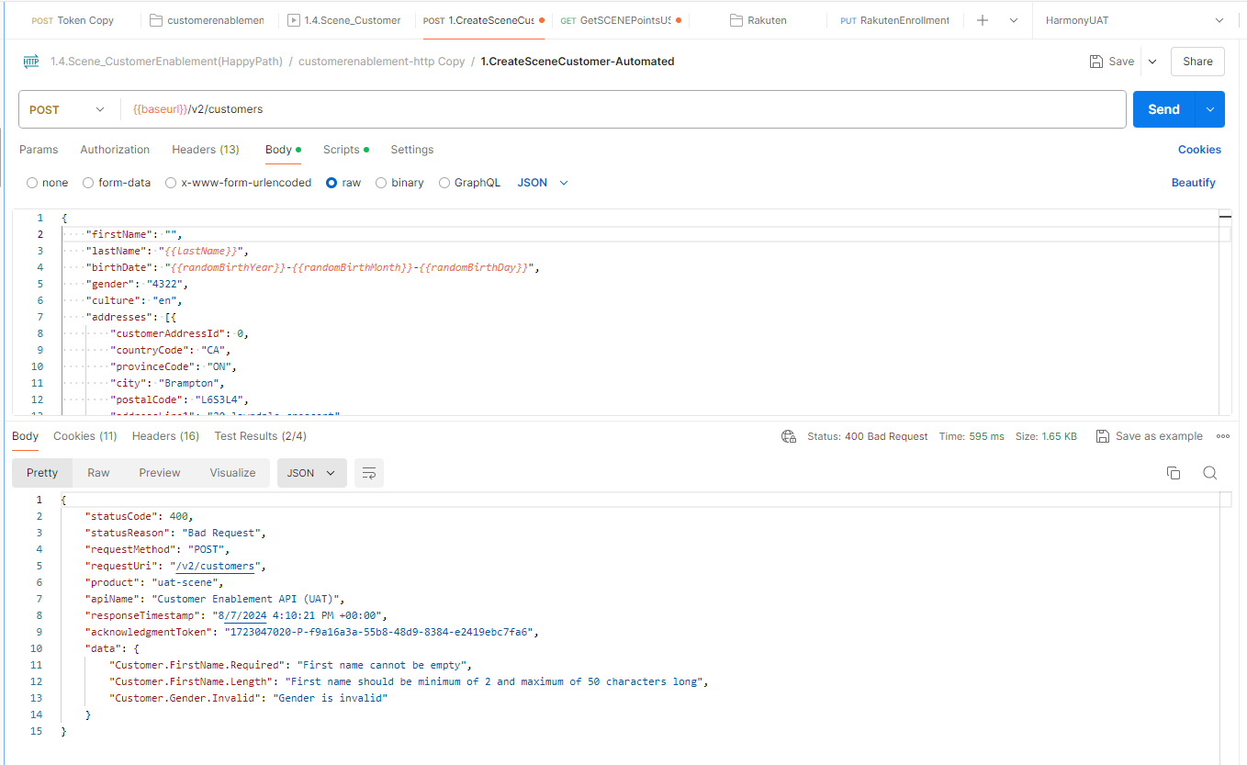

Slide 7
Scene+: User migration from B2C to OKTA

Slide 8

Lazy Migration (During first time login)
Flow | Pros
 | Migration of users without downtime Allow users to migrate their 2FA setup Migrate users with their current passwords hence seamless migration experience for end users.
 | Cons
 | More time consuming overall to complete existing user migration Need to maintain both CIAM systems until all users are migrated to new platform Revisit integration pattern in all backend systems / middle ware to ensure integration exists with both systems to get a complete view of users in B2C system until all users are migrated to new platform. More impact on systems and employees. For instance, if a customer service representative needs to reset a password, they will have to determine if the user has been migrated to the new system or not before they can help a customer. No definite timeline to sunset existing Azure B2C leading to increased operational maintenance costs.
Start
Custom Database
Azure B2C /token endpoint
Is user in Auth0?
NO
Validate username and password against B2C
Generate access token, id token
YES
Is the password valid in Auth0?
Store the user (with claims) and password hash in Auth0
YES
Success

Slide 9
Design Considerations
User Base - 15.3M , with ~10 M active users . ~5M users are with Scotia federated identity in profile.
In Scene CIAM ( Current State) , the following account/profile types are considered -
  Users with only Scene Profile in Synapze and B2C
  Users with both Scene Profile and Scotia Profile in Synapze and B2C
  Note: The user in current state is a single account if they have a Scotia account in Azure B2C with an additional attribute indicating federated identity customer id details.
Auth0 treats all identities as separate identities by default. For example, if a user logs in first against the Auth0 database with Scene Credentials and then via Scotia Credentials later (vice versa too), these two attempts would appear to Auth0 as two separate identities.
For Scene hence there is a need to explicitly link these 2 accounts ( no user consent involved) during migration and also for new scene profile with scotia , if primary identity contains bns_cid value.

Slide 10
Configuration Details - Azure B2C <-> Auth0 Attribute Mapping for initial migration
OKTA CIC Fields | Data type | Azure B2C Fields | Data type | Definition
name | string | displayName | String | The user's full name
given_name | string | givenName | String | First name of customer
family_name | string | surname | String | Last name of customer
user_metada/phone_number | object | extension_6763e55b6ff14605ae1d3ac83fe7aff1_SCENE_PhoneNumber | String | Primary Phone number of customer
user_metadata/synapze_customerid | object | extension_6763e55b6ff14605ae1d3ac83fe7aff1_SCENE_CustomerId | guid | Synapze _Unique ID
user_metadata/scene_access_flag | boolean | extension_6763e55b6ff14605ae1d3ac83fe7aff1_SCENE_AccessFlag | Boolean | Used for security fraud check
user_id | uuid | objectId | guid | OKTACIC's Unique ID
email | string | mail | string | Unique Customer Email Address
user_metadata/bns_cid | string | federated | string | BNS Customer ID (CID) - users who do not have Scotiabank account won't have this field tied to their account
user_metadata/migration_linking_status | string | migration_status | string | Status of the user during migration

